Slide 1
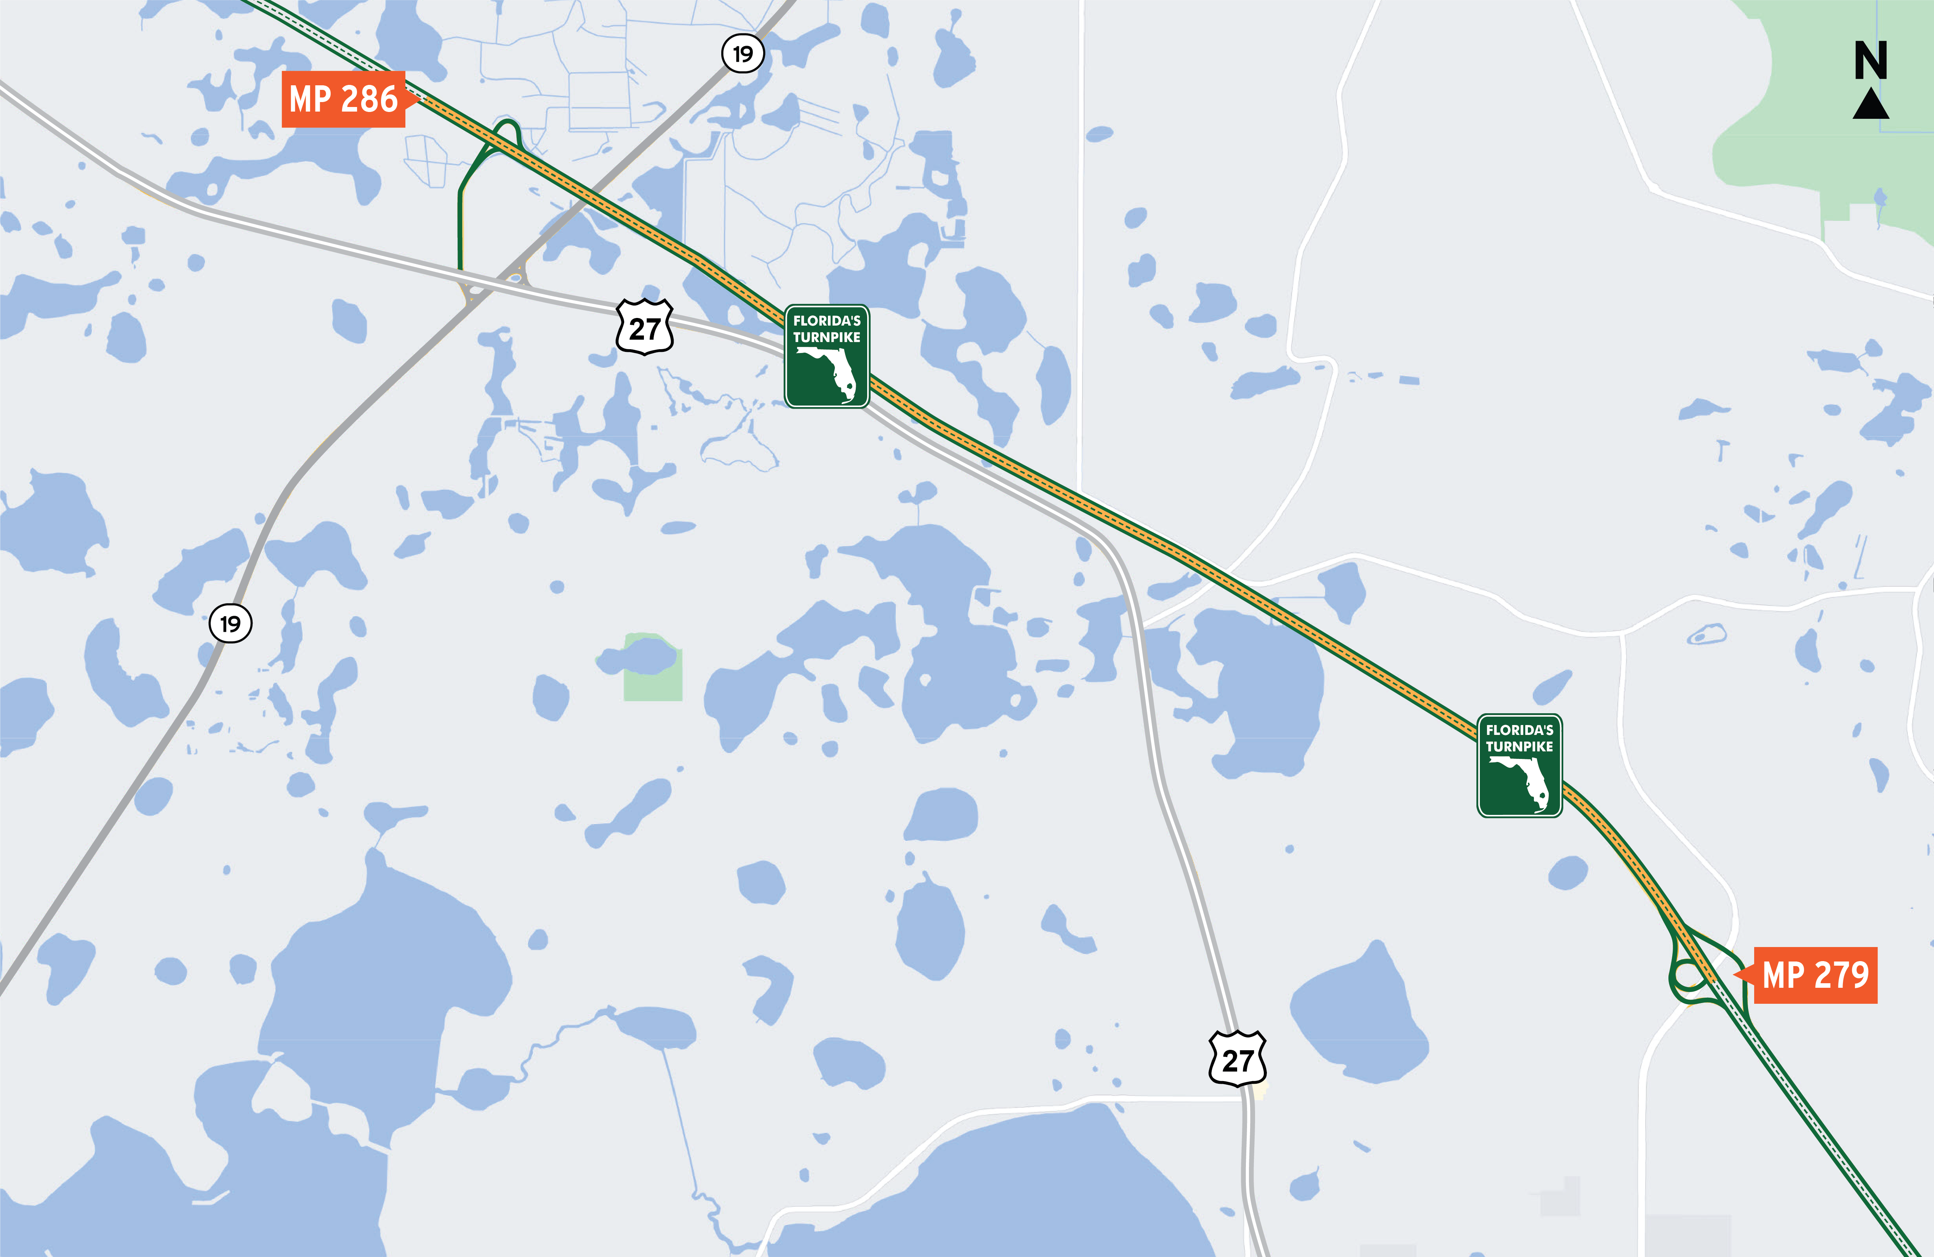
Florida’s Turnpike/SR 91 Widening from Minneola/Hancock Road to O’Brien Road
Florida’s Turnpike Enterprise is widening Florida’s Turnpike/SR 91 from Minneola to O’Brien Road
Widening roadway from two to four lanes in each direction.
Reconstruction of all bridges within project limits
Construction began in Fall 2022
Anticipated completion in mid-2028

Slide 2
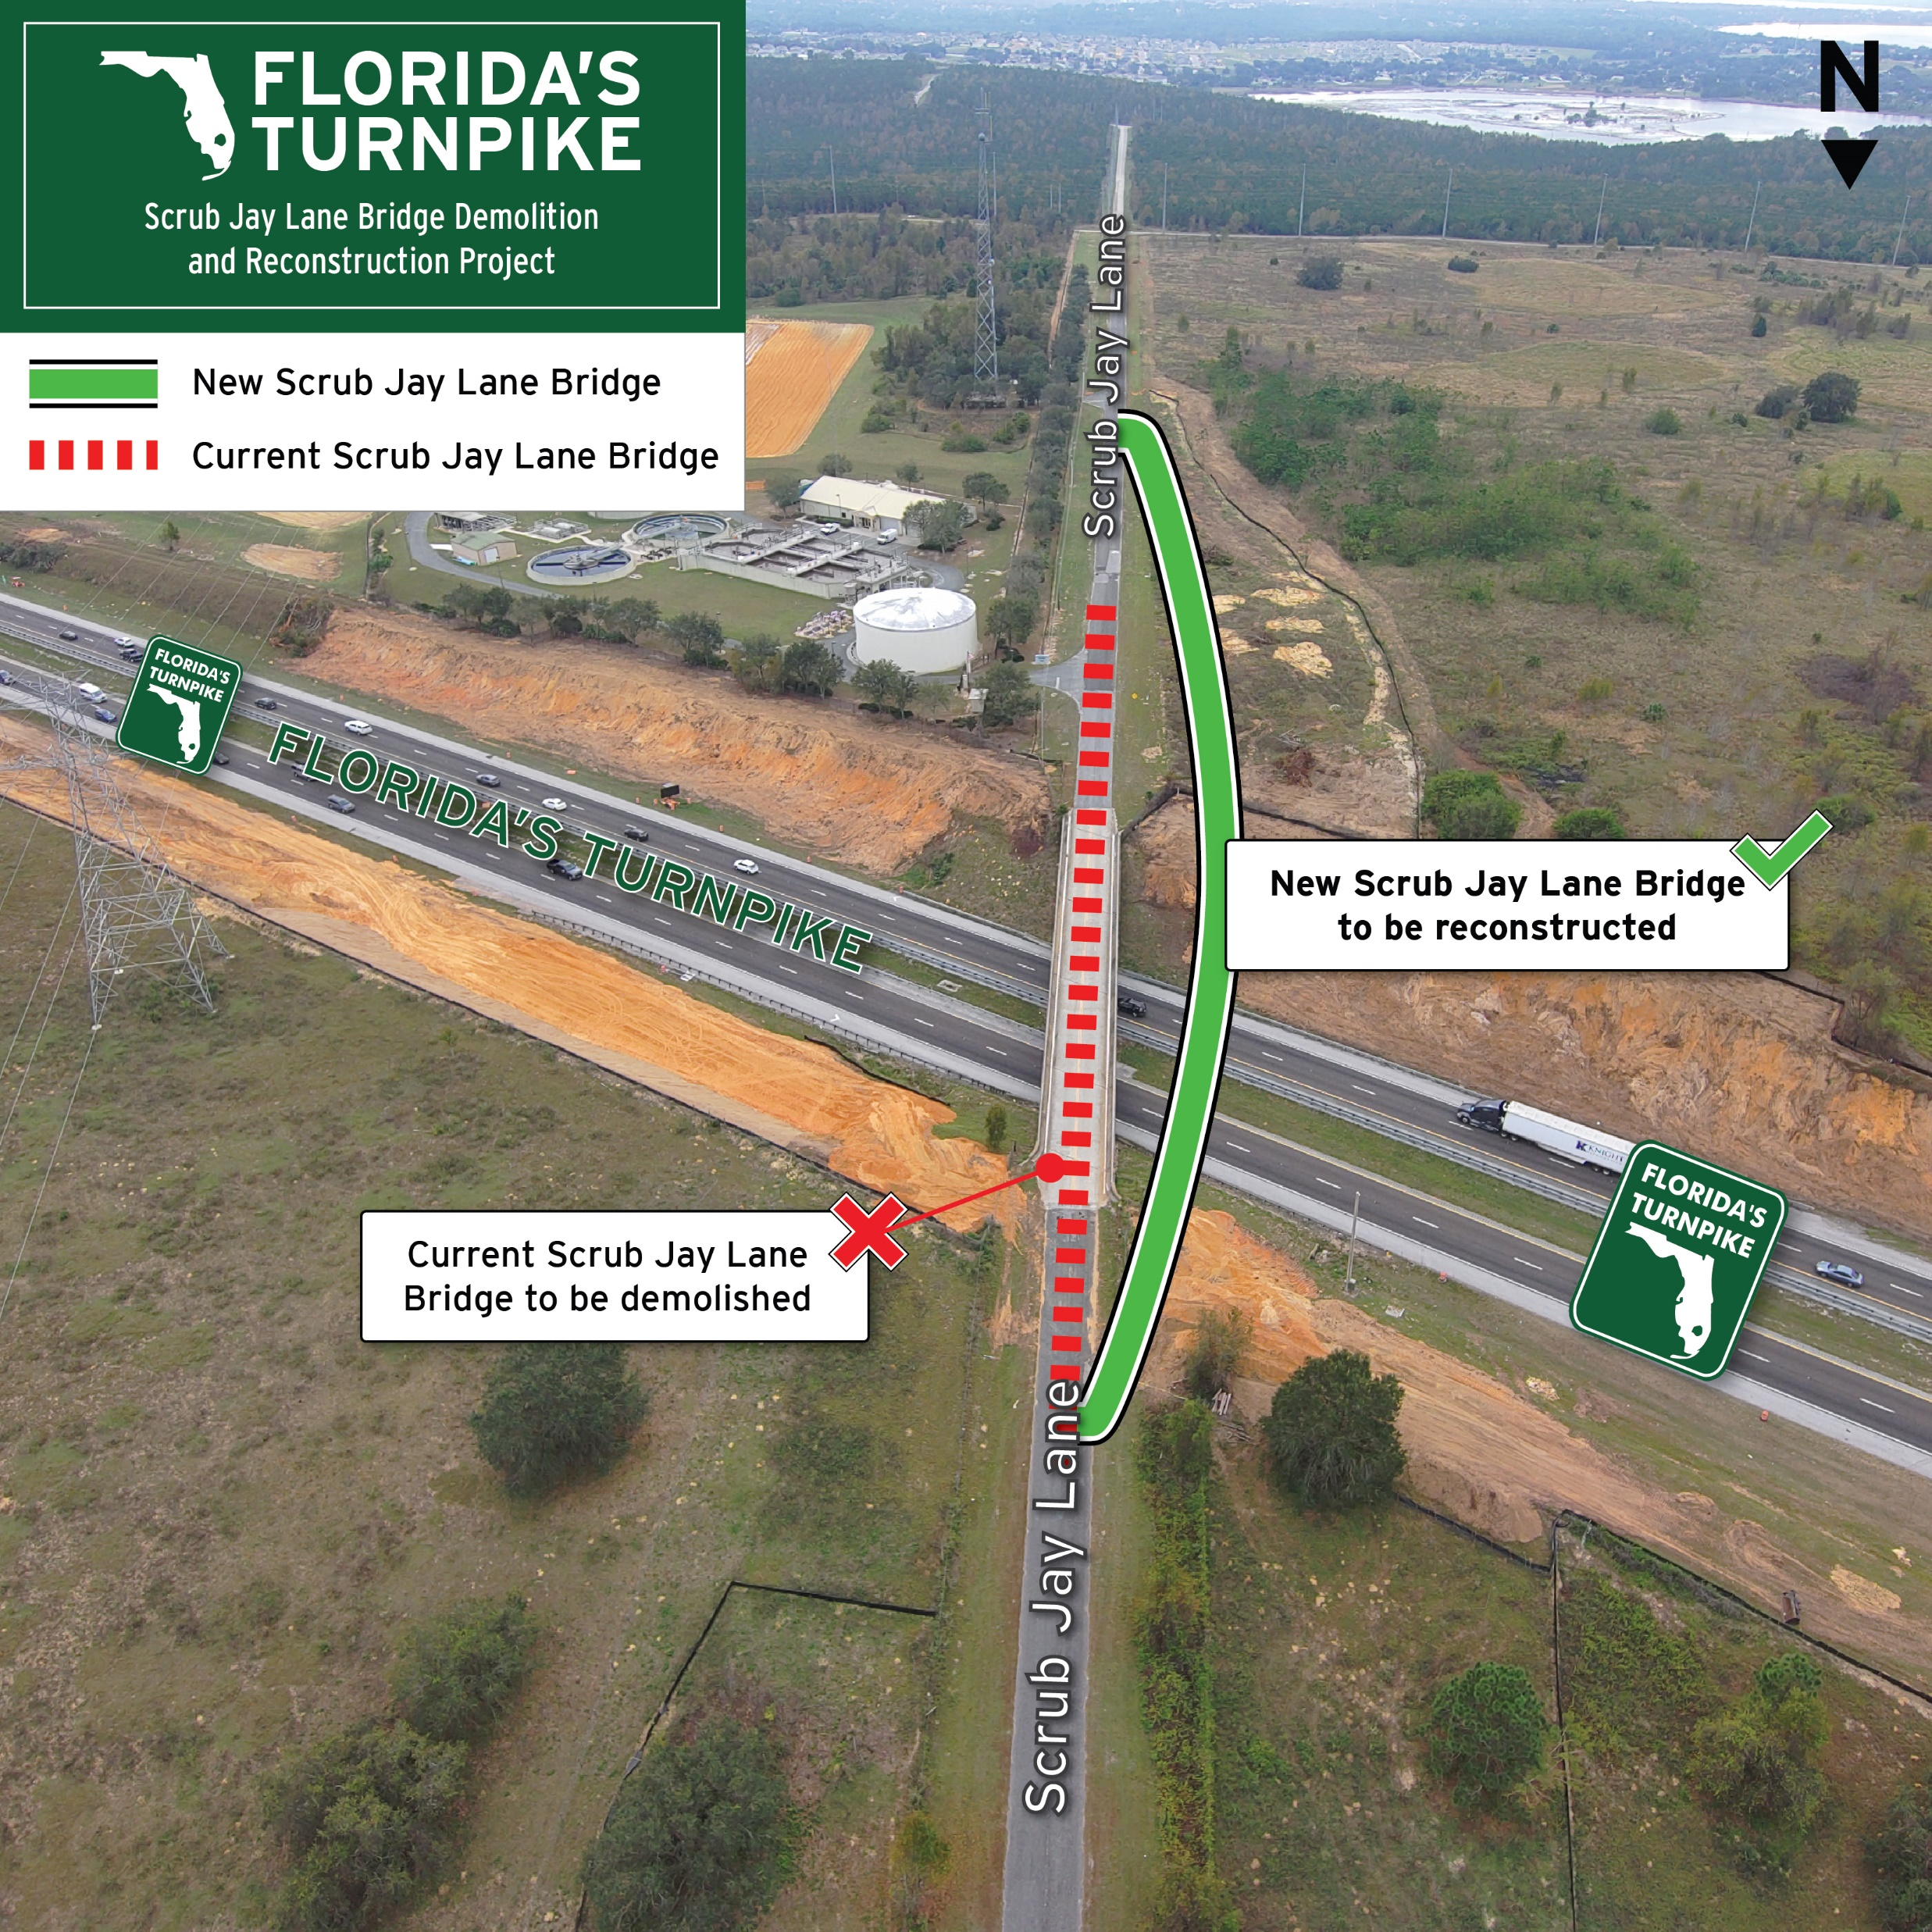
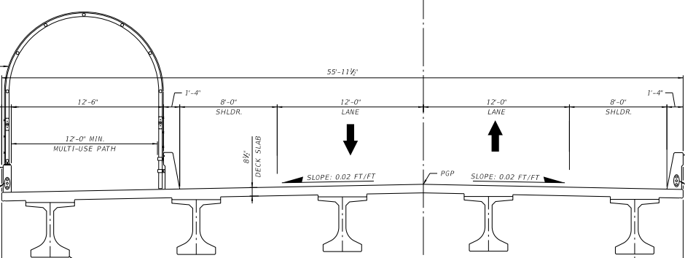
Scrub Jay Lane Bridge Closure
Scrub Jay Lane bridge will be closed, and traffic detoured
Full closure of the bridge will expedite construction activities
New Scrub Jay Lane bridge will open in approximately one year

Slide 3
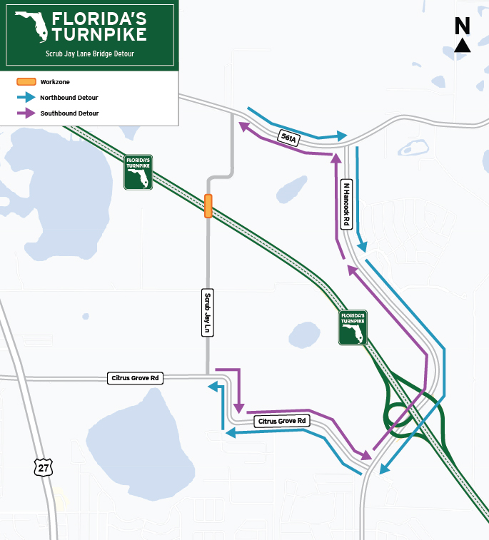
Scrub Jane Lane Bridge Detour
Northbound Scrub Jay Lane traffic will be directed south to Citrus Gove Road, southeast on Citrus Grove Road to N. Hancock Road, north on N. Hancock Road to CR 561A and west on CR 561A to Scrub Jay Lane
Southbound Scrub Jay Lane traffic will be directed north to CR 561A, east on CR 561A to N. Hancock Road, south on N. Hancock Road to Citrus Grove Road and northwest on Citrus Grove Road to Scrub Jay Lane

Slide 4
Benefits of Bridge Closure
Community Impacts
Expedite Construction
Enhances Safety
Minimal impacts to residents
Minimal impacts to wastewater treatment facility
Expedite construction by 6-9 months
Demolishing bridge allows complete equipment access
Separates construction zone
Eliminates 24-hour one-way traffic flagging operations

Slide 5
Have questions or comments?
Please contact the project team:
Virgil Rook, P.E.
Project Manager
Virgil.Rook@dot.state.fl.us
407-468-6240
Yasir Mercado
Community Outreach Specialist
Yasir.Mercado@dot.state.fl.us
954-934-1138

